Slide 1
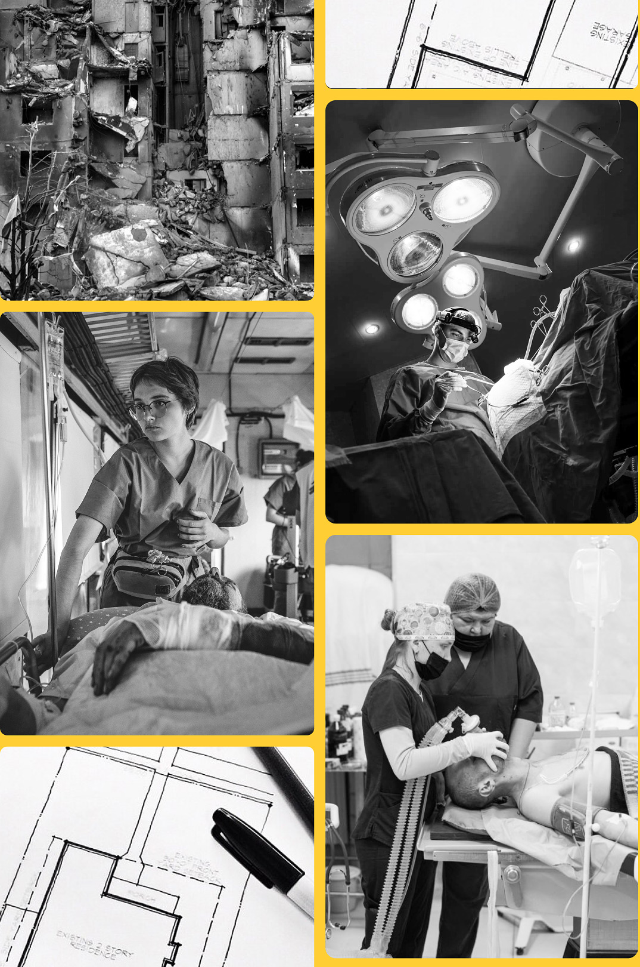

Save emergent patients under bombing in Ukraine
Designing a shelter operating
room and emergency area for the
Dnipro city hospital
CAS Rebuild Ukraine Program
Swiss Center for Design and Health
Dnipro Hospital №6
State Secretariat for Economic Affairs, CH
A pilot project scalable across all country
Wartime functionality

Slide 2

Problem
Solution
Medical institutions in Ukraine are in constant danger
A scalable project to provide hospitals with a shelter operating room and emergency area
Among the medical infrastructure, the Russian occupiers destroyed 190 medical facilities - they cannot be restored
Another 1,447 objects were damaged. But it must not stop doctors and patients who need help
Unfortunately, even if the hospital in Ukraine is fortunate enough to have a bomb shelter, it is unsuitable for operations

Slide 3
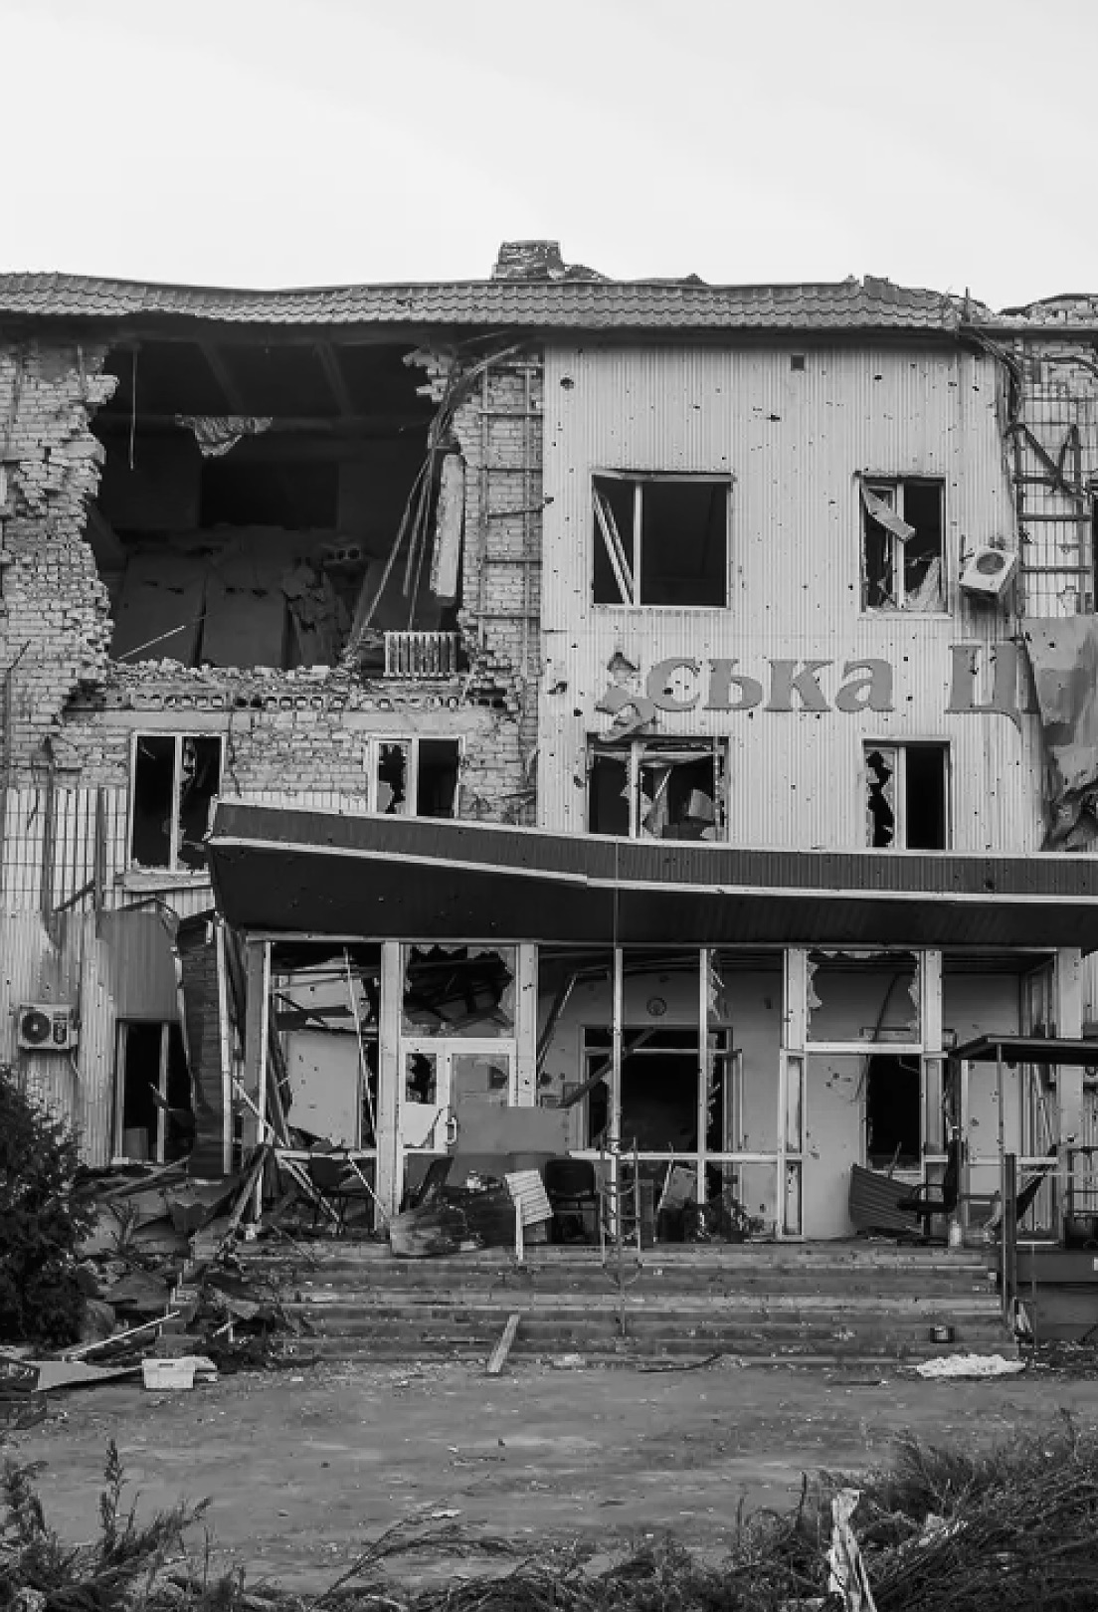
Stakeholders and scalability
Hospitals patients and their families
Hospital management
Hospital staff
City’s authorities and community
Donors
Ukraine’s recovery agency
...
The Russian army is responsible for 1,475 attacks on healthcare units
Among casualties are 630 health facilities, impacting the treatment of an average monthly total of 454,768 individuals
The Ukrainian population lives constantly under the threat of chemical, biological, radiological and nuclear emergency

Slide 4


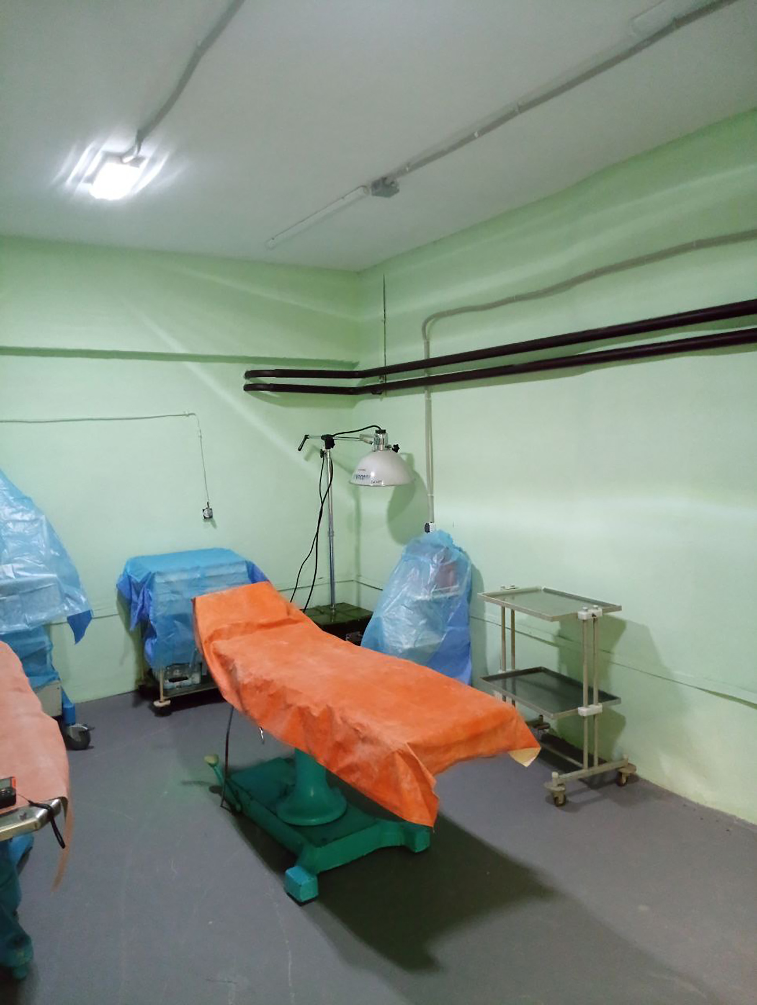
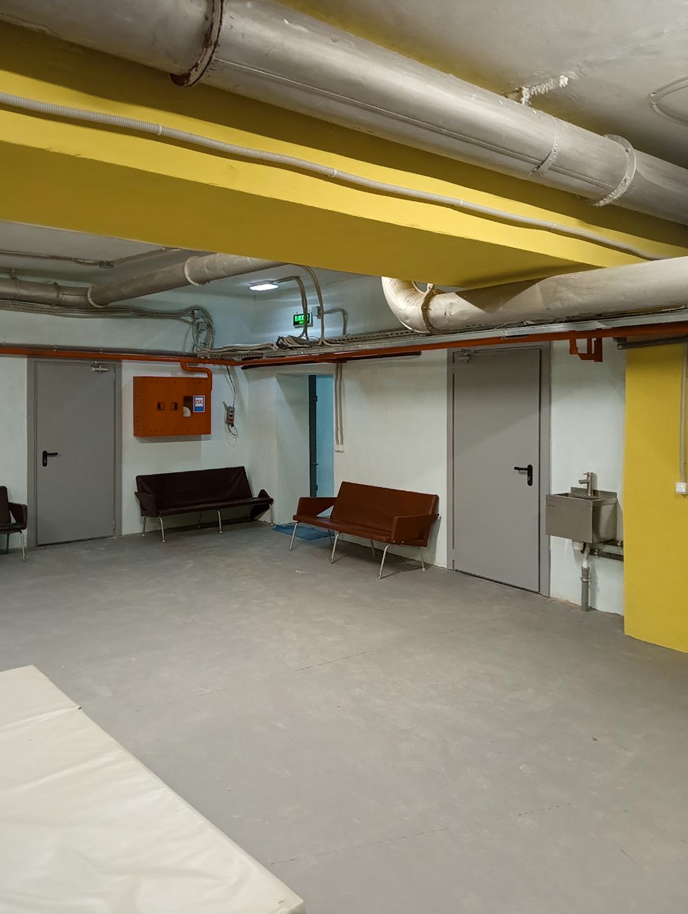
Status
IDEA
MVP
PROJECT
EXPANSION
With partnership of Swiss Center for Design and Health (SCDH) we designed an MVP for a new surgical unit within the existing bomb shelter in Dnipro Hospital №6.
The unit will feature a modern, technologically advanced operating theater and all necessary facilities.

Slide 5
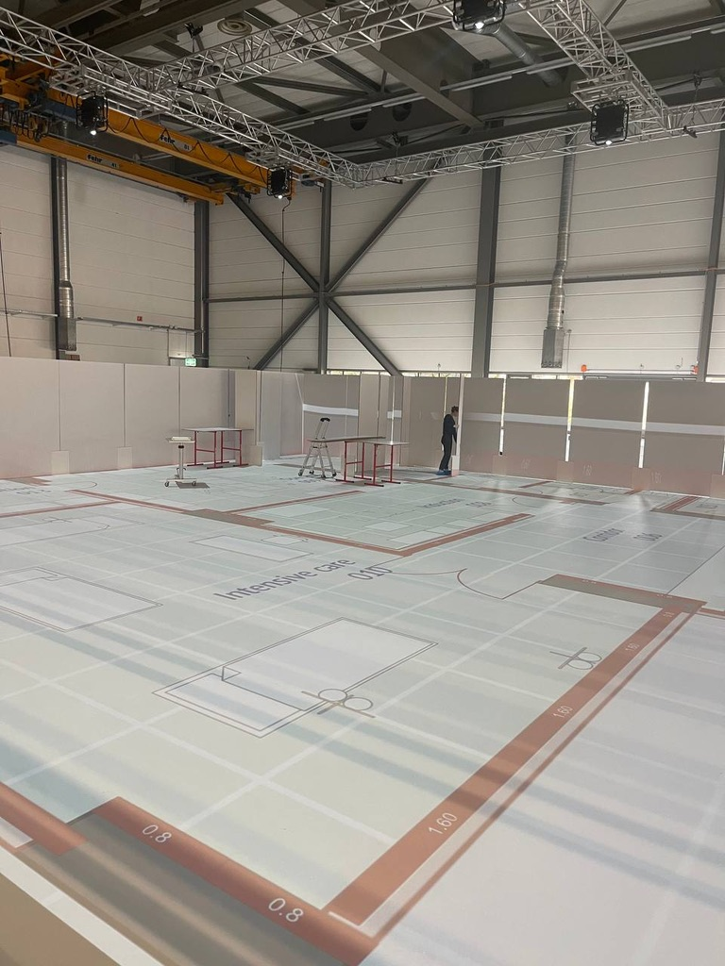
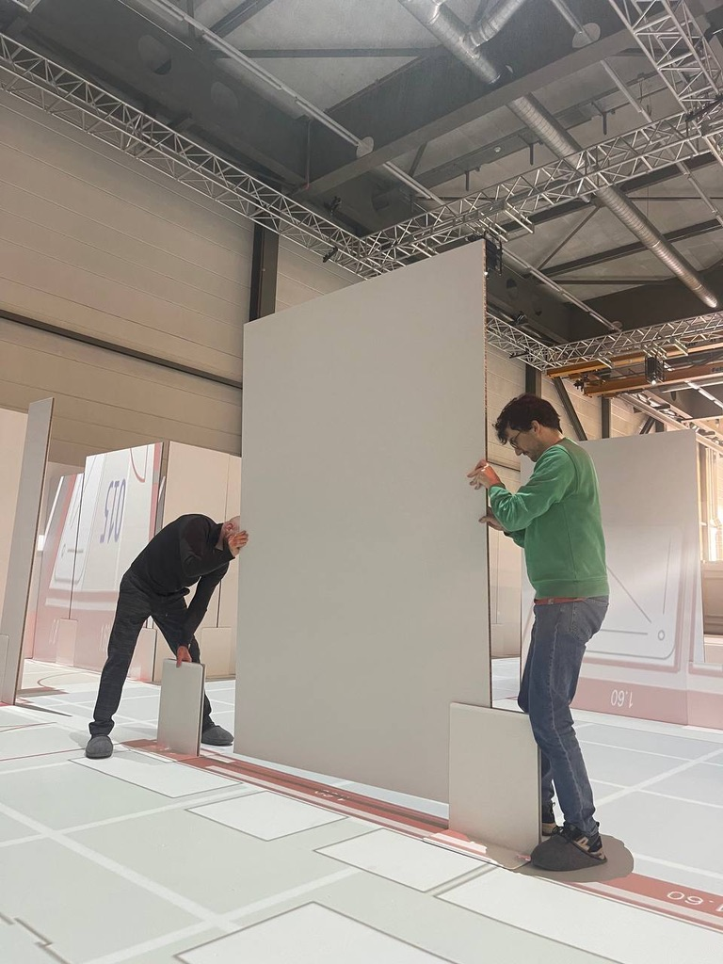
What we have already done.
Cooperation, co-creation, technology
Simulation cutting edge technology provided by
the Swiss Centre for
Design and Health, Biel/Bienne, CH

Slide 6
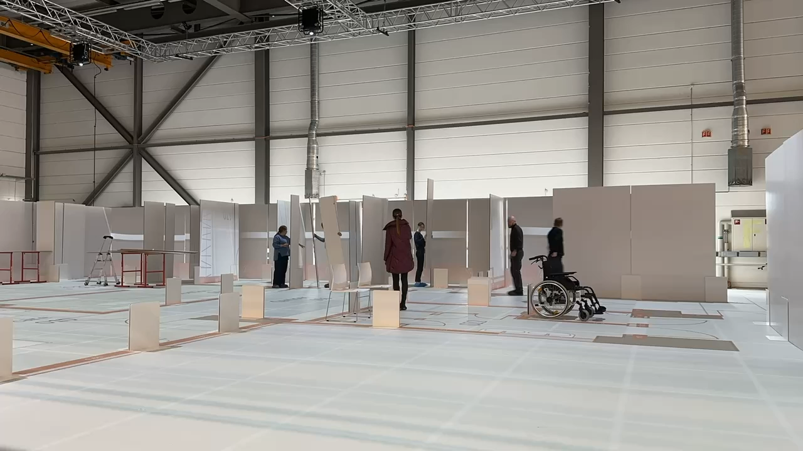

Slide 7
What we have
already done.
Expertise and
administration
01 Engaged a professional architect team
02 Developed an optimal layout for the project
03 Conducted evaluation of existing structure in Ukrainian hospitals
04 Provided advice on medical technology to ensure alignment with standards
05 Reviewed plans and layouts using SCDH simulations
06 Simulated medical team navigation during bombing with SCDH tech
07 Incorporated insights gathered through interviews with on-site experts and doctors
08 Analyzed, corrected, and finalized architect and engineering plans based on recommendations from SCDH and Dnipro Hospital

Slide 8

OUR EXPERTS
Our partners
CAS REBUILD
UKRAINE PROGRAM
helps to identify, evaluate, co-design and lead projects for rebuilding Ukraine
SWISS CENTER
DESIGN FOR HEALTH
Switzerland's largest simulation hub for early error detection and process optimization
DNIPRO
HOSPITAL NO. 6
commodates 12931 patients per year and employs 129 staff members. Built in 1989

Slide 9
Next steps
01
02
03
Develop a detailed working project including heating, water supply, ventilation, electrical etc
Preparing cost estimates documentation
Commission a state construction expertise to verify the project's compliance with regulations and the cost of materials and labour
Fundraising from the government, international organizations and donors
Duration: 1 month
Duration: 2 months
04
05
Conduct procurement for construction through the electronic PROZORO system
Carry out construction and commission the facility
Duration: 4 month

Slide 10
What help do we need
EXPERTISE AND APPROACHES OF SWISS COMPANIES IN THE FIELD OF CONSTRUCTION AND ARCHITECTURE
MEDICAL
EQUIPMENT
Space simulation conducted by SCDH
Procurement of medical equipment from manufacturers
Waterproofing and Strengthening SIKA company
Accommodation of old but functional equipment from CH hospitals in Ukrainian medical units
Continuous power supply systems by DkW company
Using mixtures and additives for robust shelter coverings
Water supply systems supplied by Geberit company
SUPPLY OF MATERIALS AND EQUIPMENT FOR CONSTRUCTION
Installation of ventilation and heating systems
Utilization of new materials for sound absorption
FUNDRAISING

Slide 11

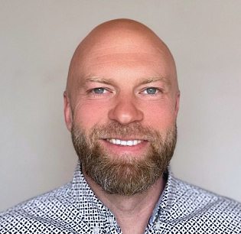
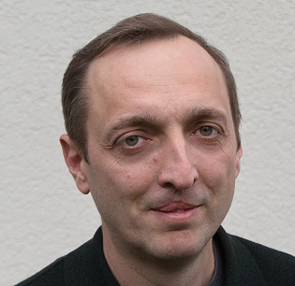


Our team
Lead
Construction expert
Architect
Architect
Communication
ALLA
OLIINYK
DMYTRO
VOVK
MAKSYM
DANYLIUK
MARYNA
METSGER
KATERINA
VYNOGRADOVA
MD, MBA, executive manager, entrepreneur in life science field 20+ years of experience
Founder of the construction company, CC STEK, 20+ years of experience in construction field
Creating spaces for living, working and enjoying life 20+ years of experience
Professional athlete, artist, and passionate architect
Department of Social Protection of the regional state Administration of Zaporizhzhia, Ukraine

Slide 12
Save emergent patients under bombing
in Ukraine
ALLA
OLIINYK
MAKSYM
DANYLIUK
alla.oliinyk@gmail.com
epilandrus@gmail.com
DMYTRO
VOVK
MARYNA
METSGER
dmirovovk@gmail.com
mary.metsger@gmail.com
KATERYNA
VYNOGRADOVA
katerinka.dream@gmail.com

